Slide 1
Restoration Advisory Board Meeting
May 9, 2018

Slide 2
Agenda
January Meeting Minutes
Frost Effects Research Facility Vapor Intrusion Investigation
Soil Vapor Extraction Pilot Testing - Enhanced Permeability of the Shallow Soils
Smoke Testing (Round 2) the Main Laboratory
Status of Feasibility Study and Engineering Evaluation/Cost Analysis reports
Public Comments
Schedule next meeting and adjourn

Slide 3
What have we been working on since our last meeting in January?
Frost Effects Research Facility Indoor Air Monitoring
Soil Vapor Extraction Pilot Test Update
Feasibility Study
Engineering Evaluation / Cost Analysis

Slide 4
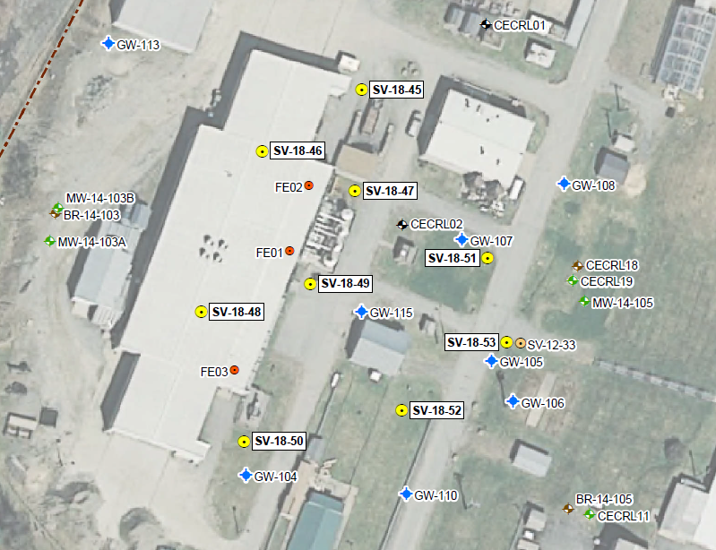

Slide 5
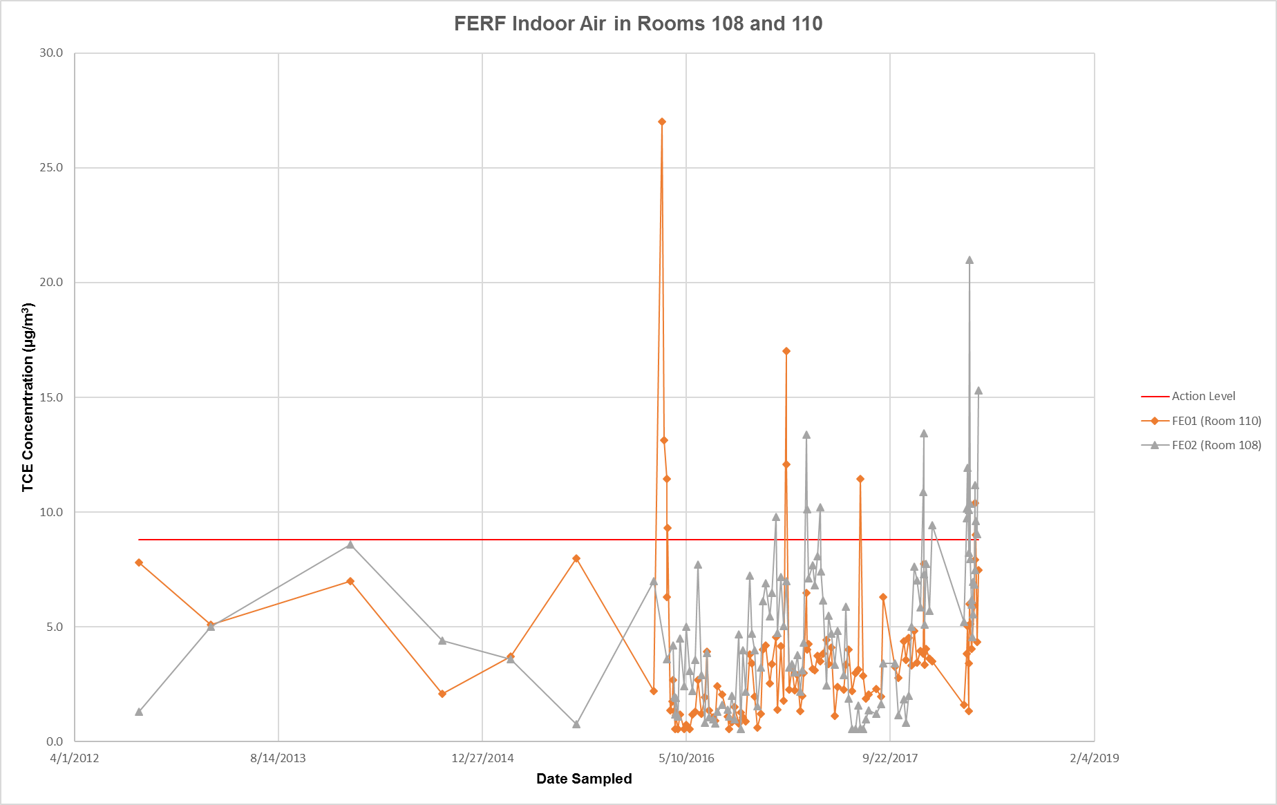
FERF Indoor Air
Indoor Air in FERF Frost Effects Research Facility Indoor Air Monitoring
Soil Vapor Extraction Pilot Test Update
Feasibility Study
Engineering Evaluation / Cost Analysis

Slide 6
FERF Vapor Intrusion Sampling
Conducted April 26th under barometric low atmospheric conditions.
35 indoor air samples collected and analyzed by HAPSITE®.
3 sub slab vapor samples collected and analyzed by HAPSITE®.
Conducting variability sampling this week under barometric high and low atmospheric conditions.

Slide 7
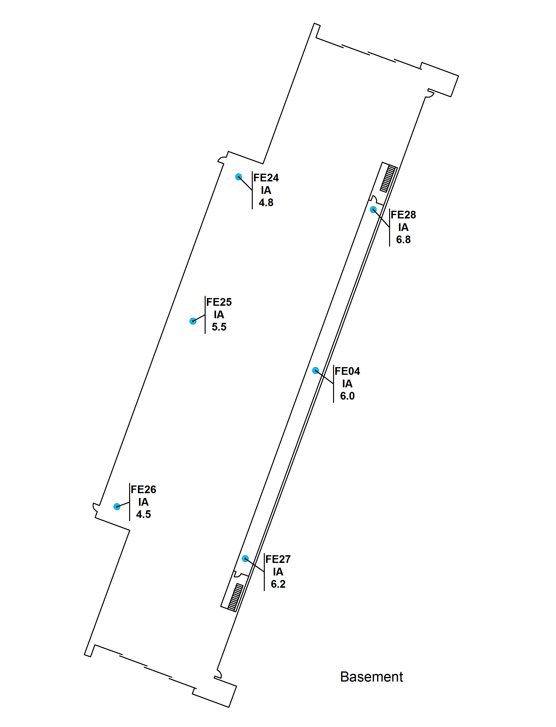

Slide 9
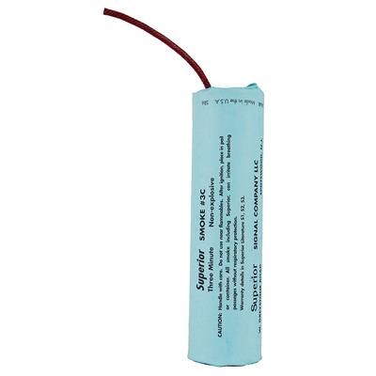
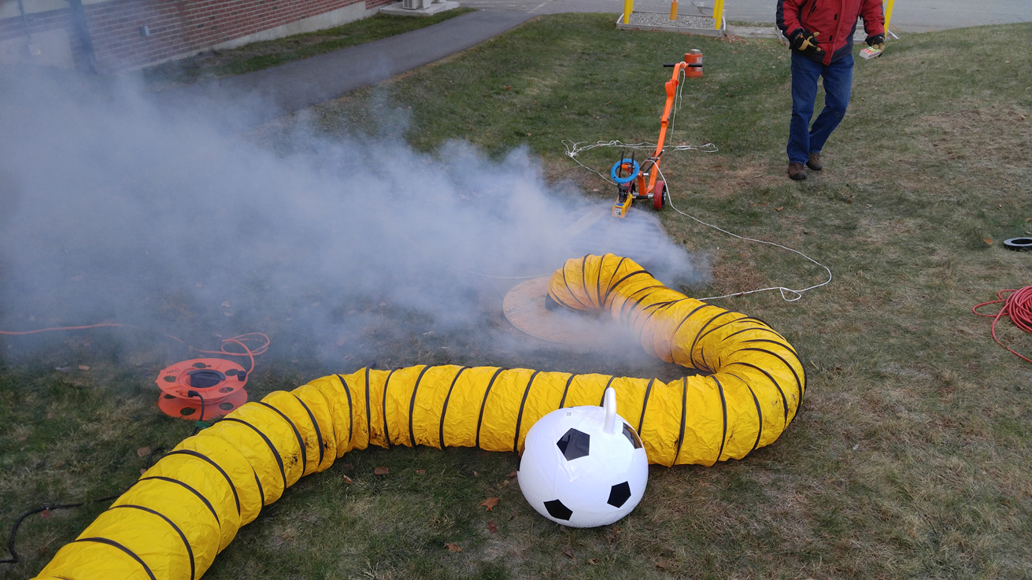
Smoke Testing II of the Main Lab
Storm Drain
Sanitary Sewer

Slide 10
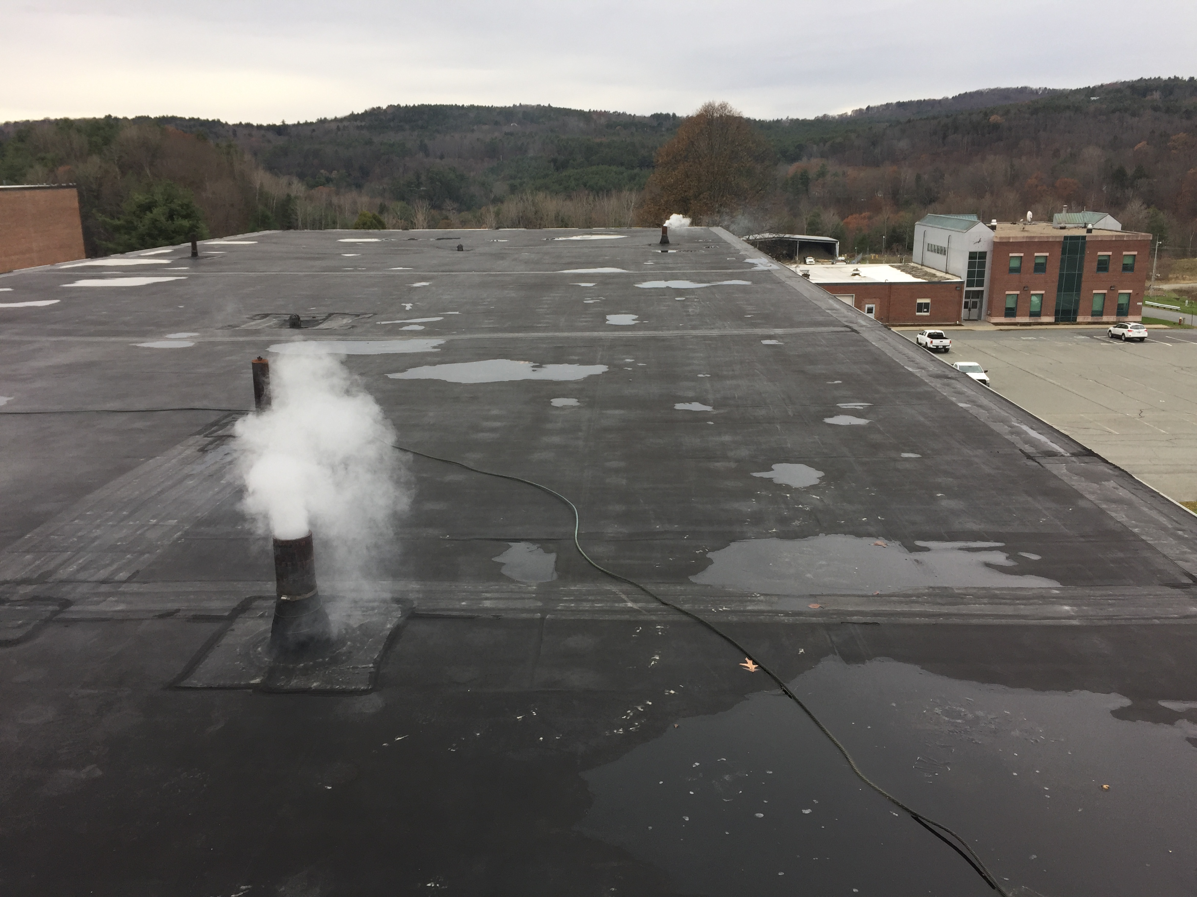
Smoke Test II Objectives
Smoke an indicator of vapor intrusion pathways.
Evaluate if HVAC and plumbing fixes were effective.
Evaluate/locate other specific points of leakage potentially masked by Smoke Test I HVAC and plumbing pathways.

Slide 11
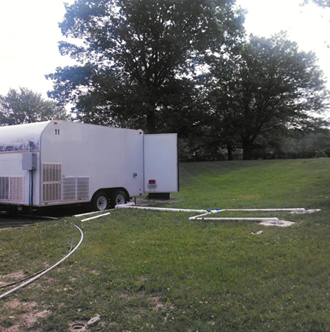
Soil Vapor Extraction Pilot Testing – Enhanced Permeability of Shallow Soils
Three locations each to be tested at AOC 2 and AOC 9.
~5 foot intervals from 15 to 50 feet below ground surface.
Install soil vapor extraction wells at each location.

Slide 12
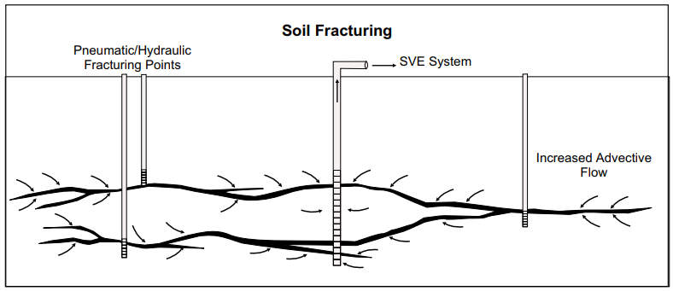
Enhanced Permeability Concept
Modified After USAF Final Guidance on Soil Vapor Extraction Optimization, June 2001

Slide 13
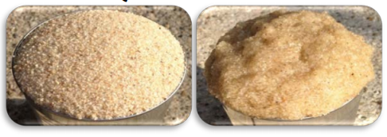
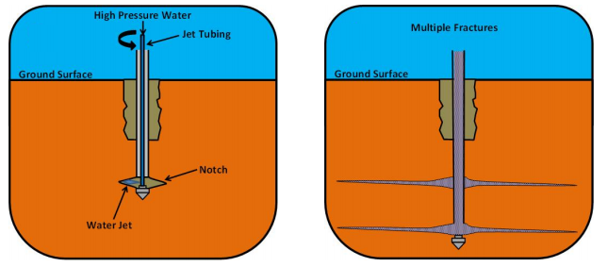
Enhanced Permeability Work Steps
Prepare Slurry
Prepare Casing
Advance to Depth
Inject Slurry
Build SVE Well
Building and Indoor Air Monitoring
Modified after Hall and Slack, In Situ Distribution of Fluid Injected Through Fractures, 2013

Slide 14
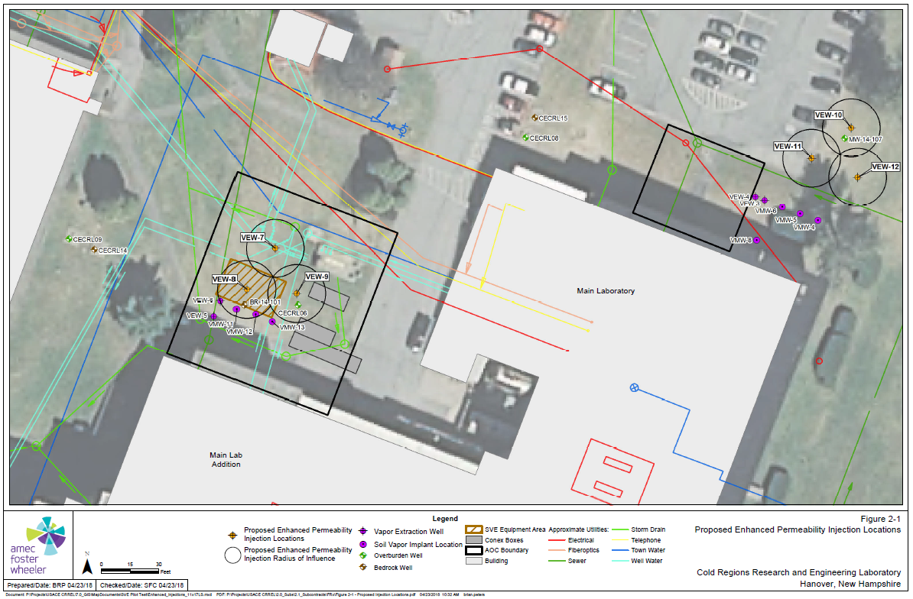

Slide 15
What will we be working on?
Draft Feasibility Study Report – ongoing review by NAE
Engineering Evaluation and Cost Analysis Report - finalized last week
Finalize Remedial Investigation Report - June
Continue to evaluate Vapor Intrusion at Frost Effects – drilling to begin on or about June 4th.
SVE pilot testing drilling to begin in late June early July.

Slide 16
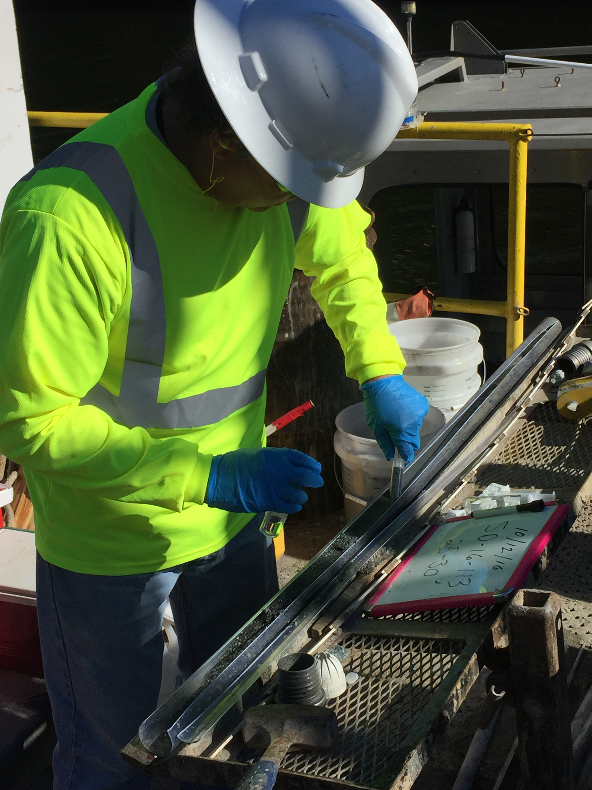
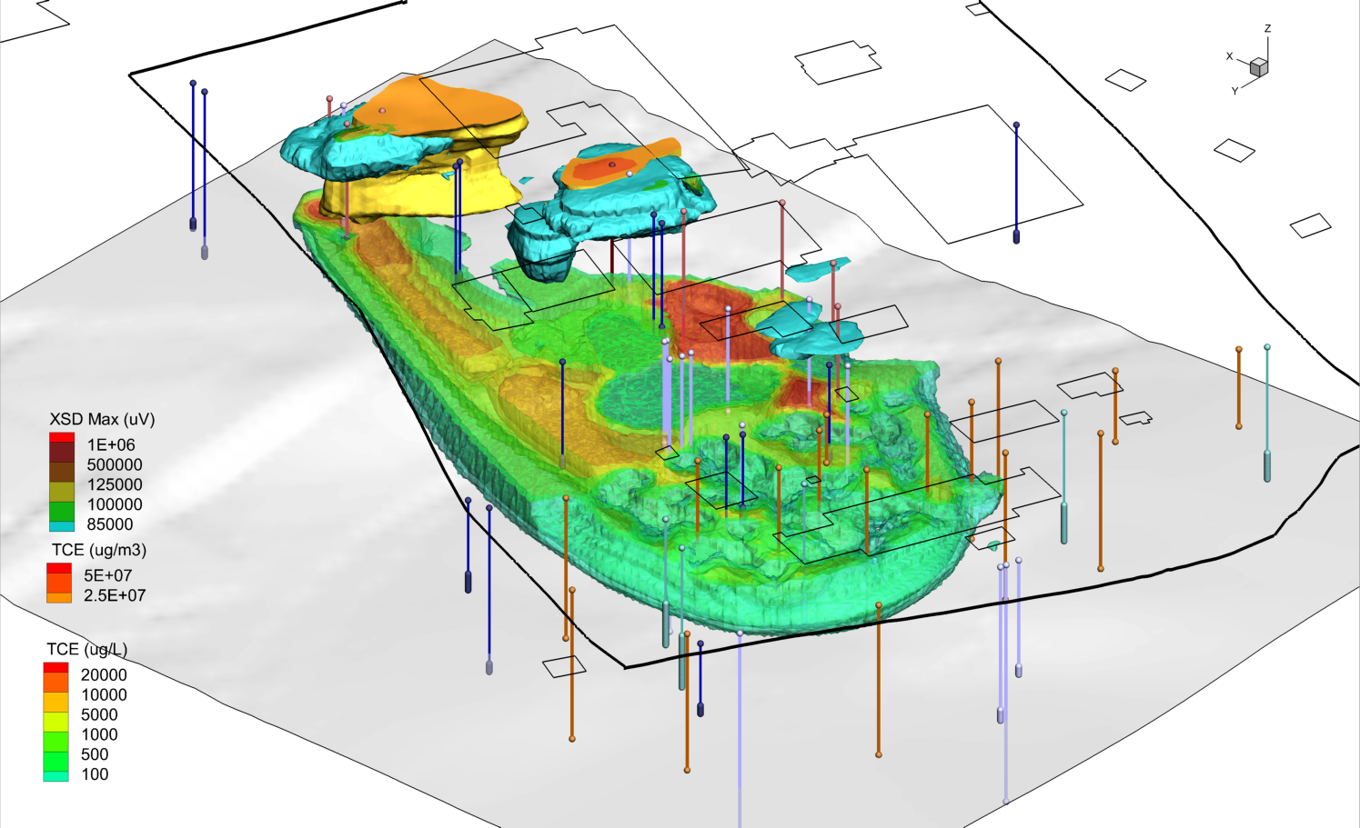
Thank You
Questions or Comments

